Slide 1


DDR review
Ma Ji
2017.12.01

Slide 2
Contents
What is DDR?
Synopsys DDR Controller
Synopsys DDR PHY
Port Arbiter
Virtual Channels
Address Mapping

Slide 3
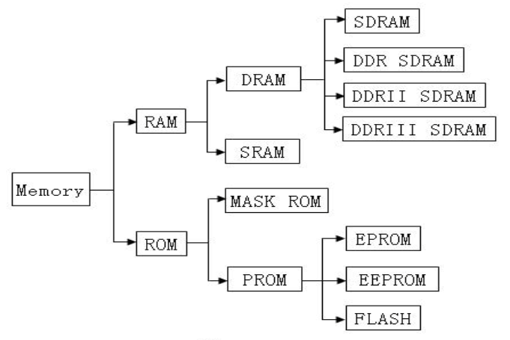
What is DDR?

Slide 4
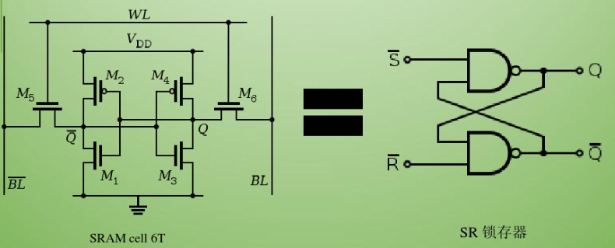
SRAM：Static Random Access Memory

Slide 5
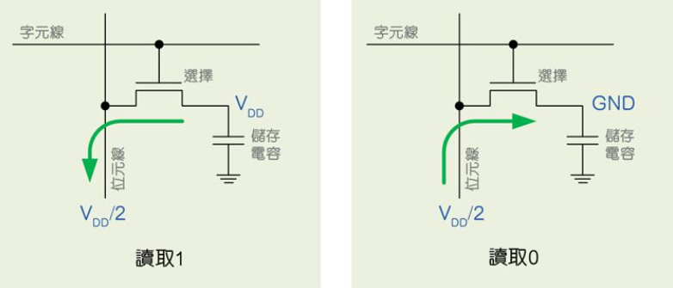
DRAM：Dynamic Random Access Memory

Slide 6
SDRAM: Synchronous Dynamic Random Access Memory
DDR SDRAM: Double Data Rate SDRAM
DDR2 SDRAM: Double Data Rate 2 SDRAM
DDR3 SDRAM: Double Data Rate 3 SDRAM
DDR4 SDRAM: Double Data Rate 4 SDRAM

Slide 7
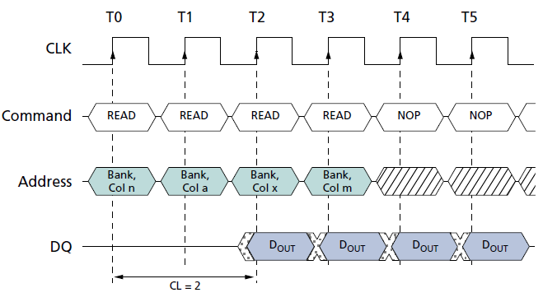
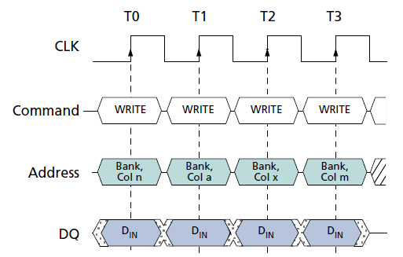
SDRAM: Synchronous Dynamic Random Access Memory

Slide 8
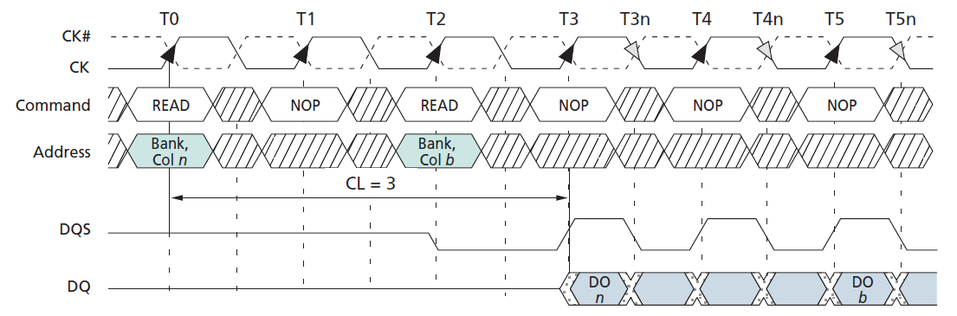
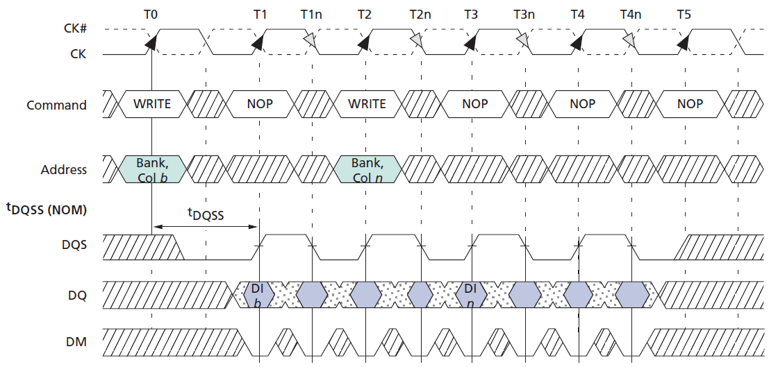
DDR SDRAM: Double Data Rate SDRAM

Slide 9
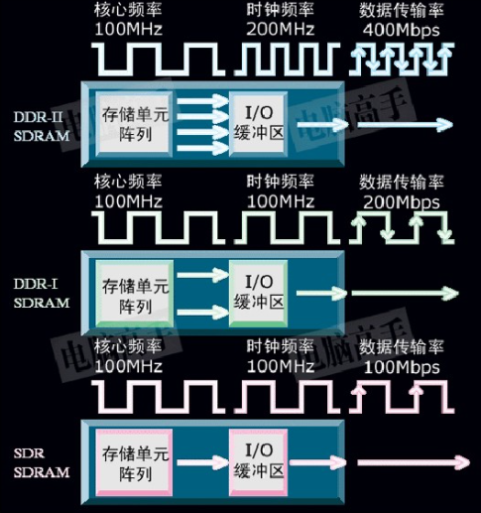
SDRAM vs DDR vs DDR2

Slide 10
SDRAM vs DDR vs DDR2 vs DDR3 vs DDR4
 | SDRAM | DDR | DDR2 | DDR3 | DDR4
Voltage | 3.3V | 2.5V | 1.8V | 1.5V | 1.2V
Data Rate | 200Mbps | 400Mbps | 1066Mbps | 2133Mbps | 3200Mbps

Slide 11
DDR3 vs DDR3L vs DDR3U vs LPDDR3
 | DDR3 | DDR3L | DDR3U | LPDDR3 | LPDDR4
Voltage | 1.5V | 1.35V | 1.25V | 1.2V | 1.1V
Data Rate | 2133Mbps | 1866Mbps | 1600Mbps | 1866Mbps | 3200Mbps

Slide 12
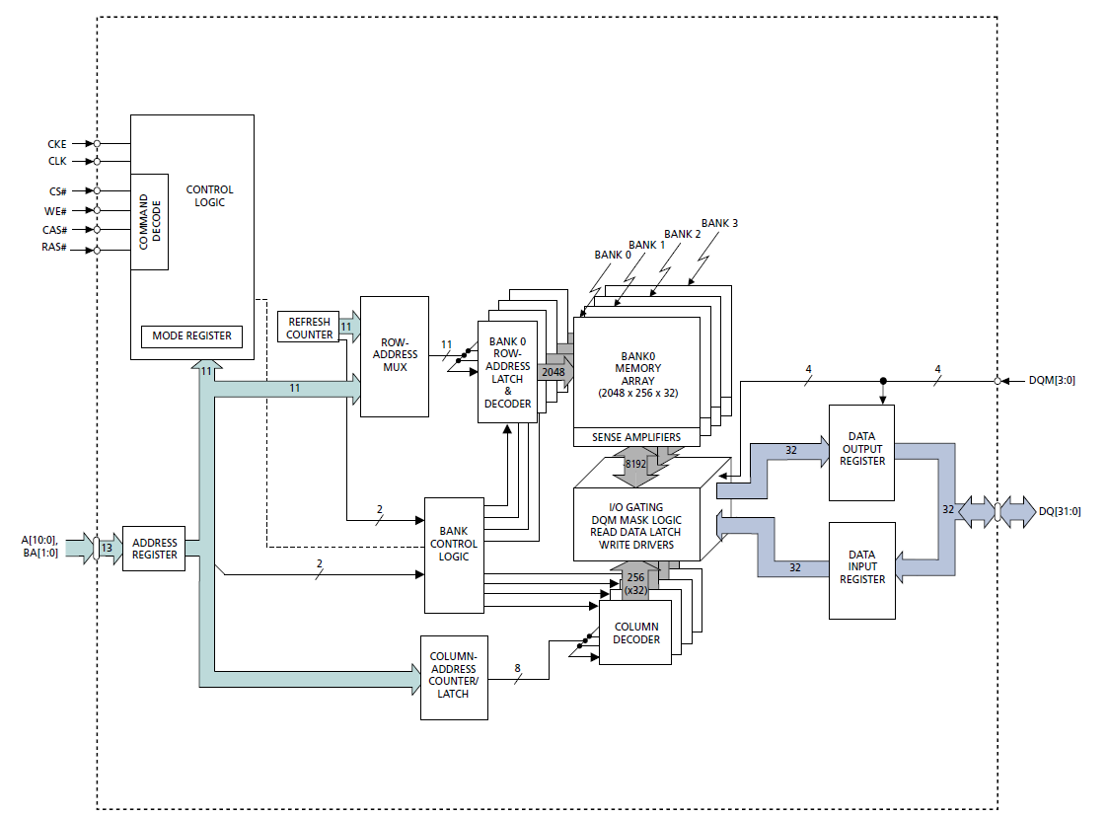
SDRAM Chip

Slide 13
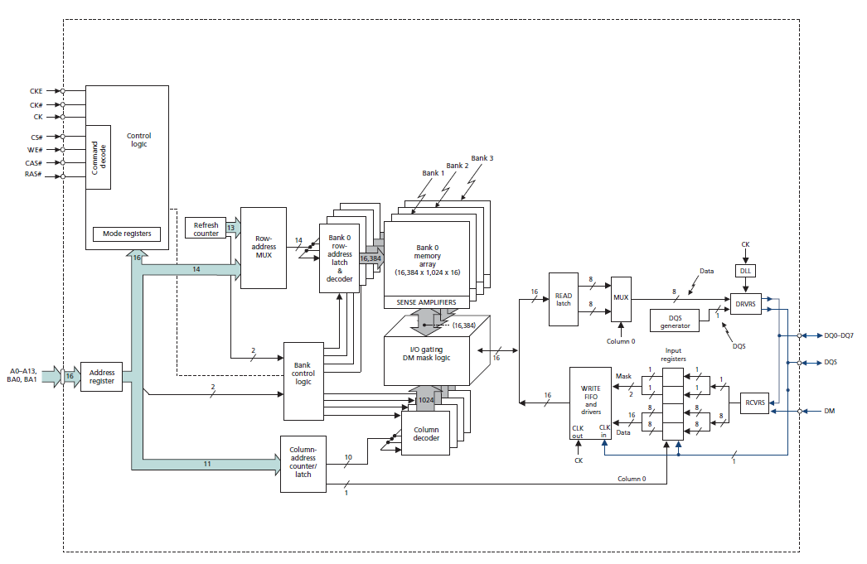
DDR Chip

Slide 14
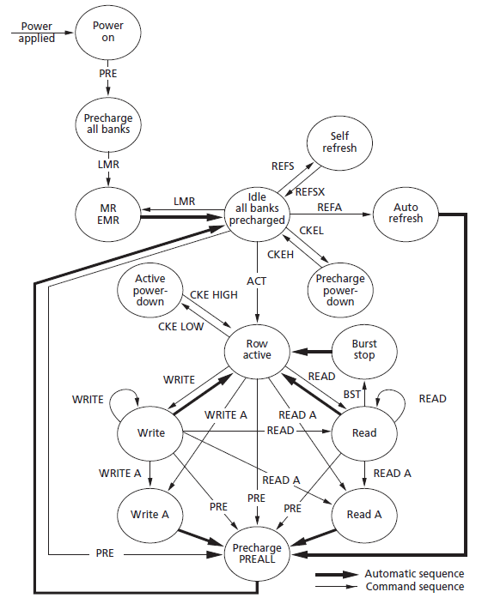
DDR State Diagram

Slide 15
Command
Active: The ACTIVE command is used to open (or activate) a row in a particular bank for a subsequent access, like a read or a write.
Read: The READ command is used to initiate a burst read access to an active row.
Write: The WRITE command is used to initiate a burst write access to an active row.
Precharge: The PRECHARGE command is used to deactivate the open row in a particular bank or the open row in all banks.

Slide 16
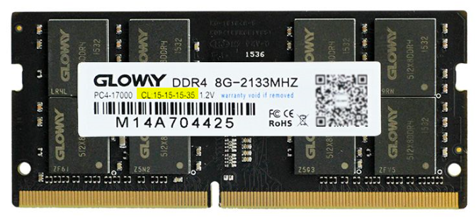
DDR parameter
tRP: PRECHARGE command period
tRCD: ACTIVE-to-READ or WRITE delay
CL: CAS(READ) latency
tRC: ACTIVE-to-ACTIVE/AUTO REFRESH command period

Slide 17
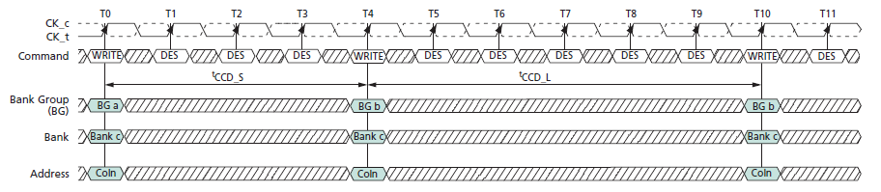
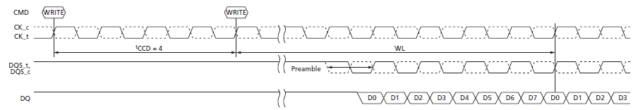
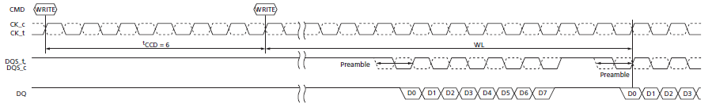
DDR4 BG Timing

Slide 18
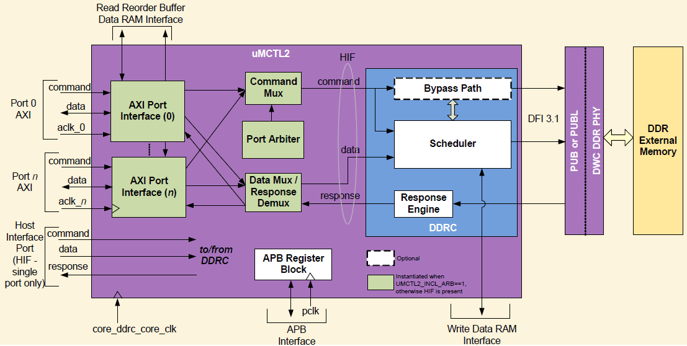
Synopsys DDR controller

Slide 19
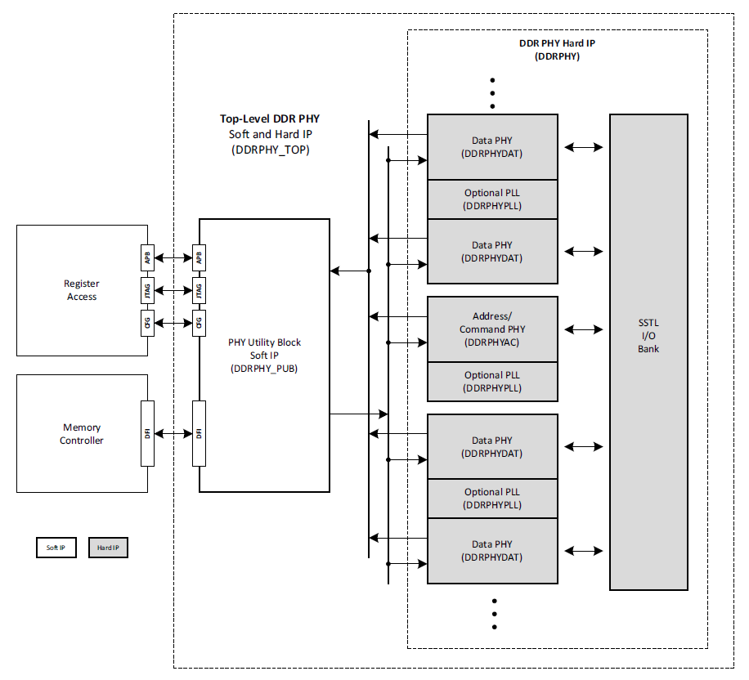
Synopsys DDR PHY

Slide 20
IP Configuration
DDR2,LPDDR2,DDR3,DDR3U,DDR3L,LPDDR3,DDR4 supported
64bits DQ,half data width and quarter data width mode supported
Inline ECC supported
1:2 frequency ratios only
2 ranks supported
4 group register for fast frequency change
6 AXI4 ports
2 system address regions supported

Slide 21
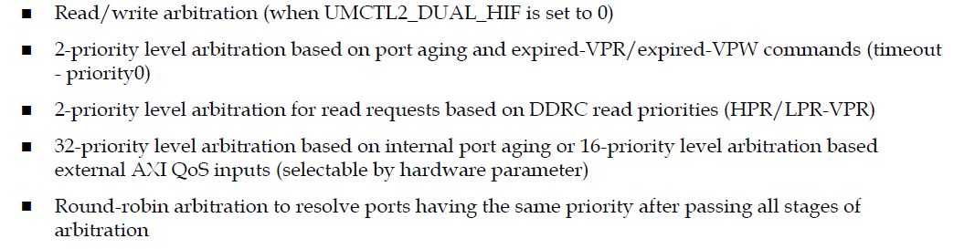
Port Arbiter

Slide 22
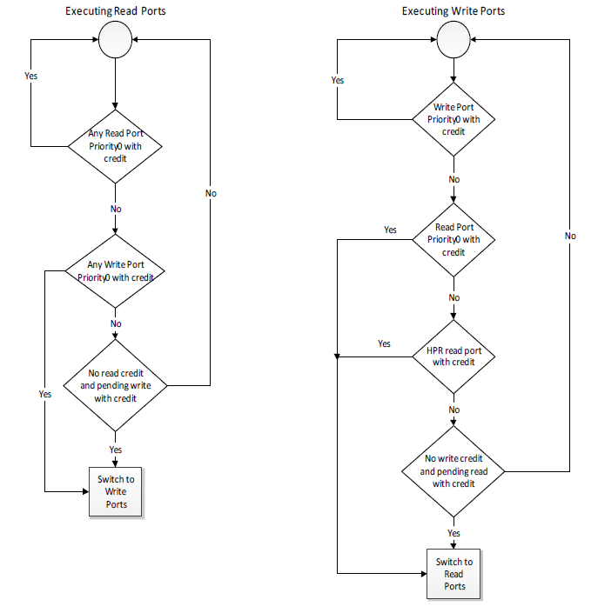
Read/Write Arbitration

Slide 23
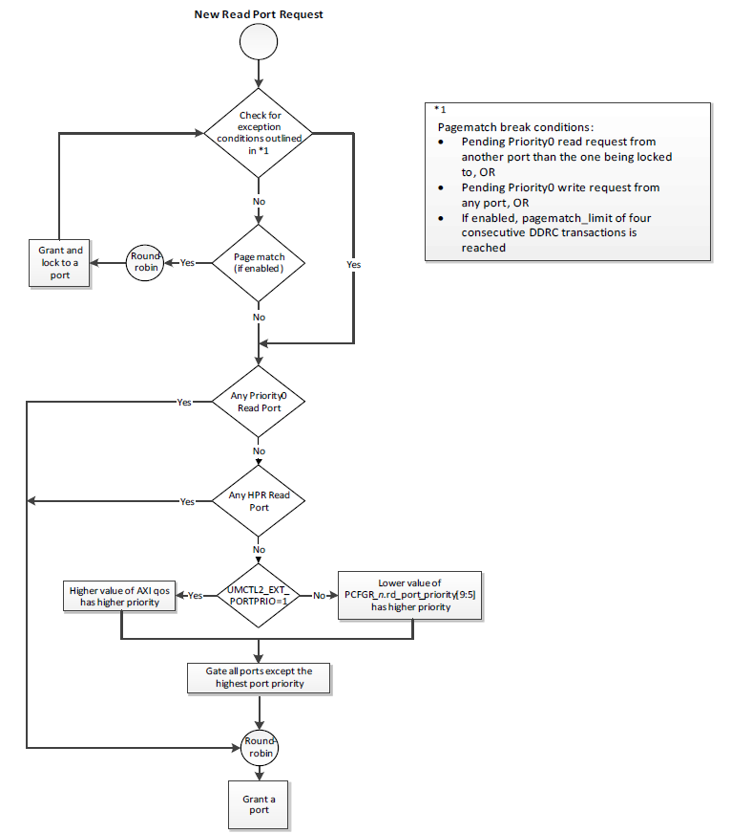
Read Arbitration

Slide 24
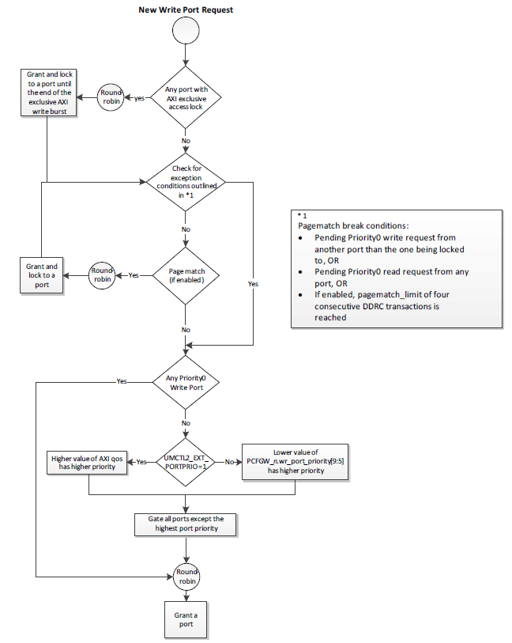
Write Arbitration

Slide 25
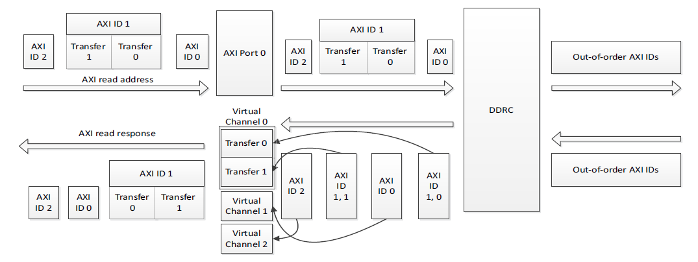
Virtual Channels

Slide 26
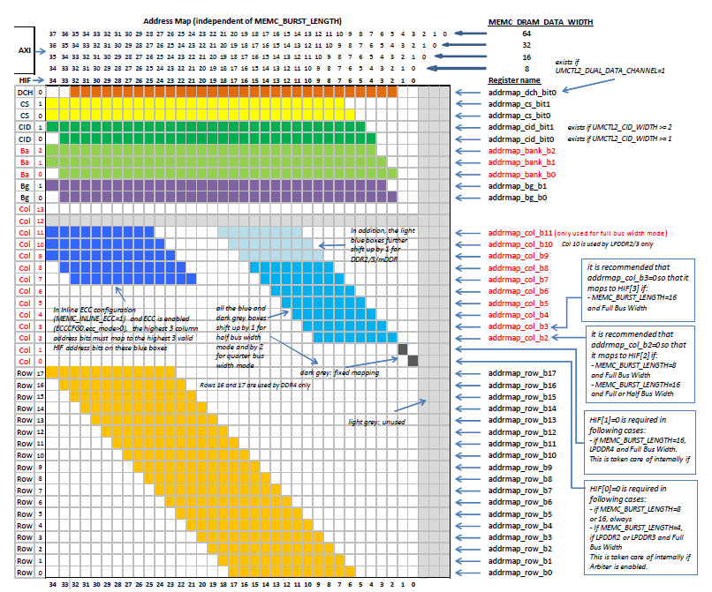
Address Mapping

Slide 27
Q&A
Thanks

